Slide 1
Large Scale Data Mining
Advanced Data Mining

Slide 2
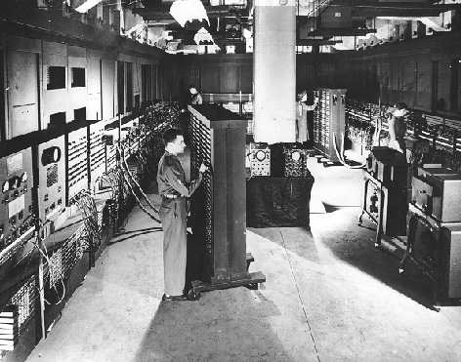
How large is large?
It depends…
In the early days (before 80s): 1 Kilobyte is big.
The first computer ENIAC has 1 KB of core memory (equivalent memory space).

Slide 3
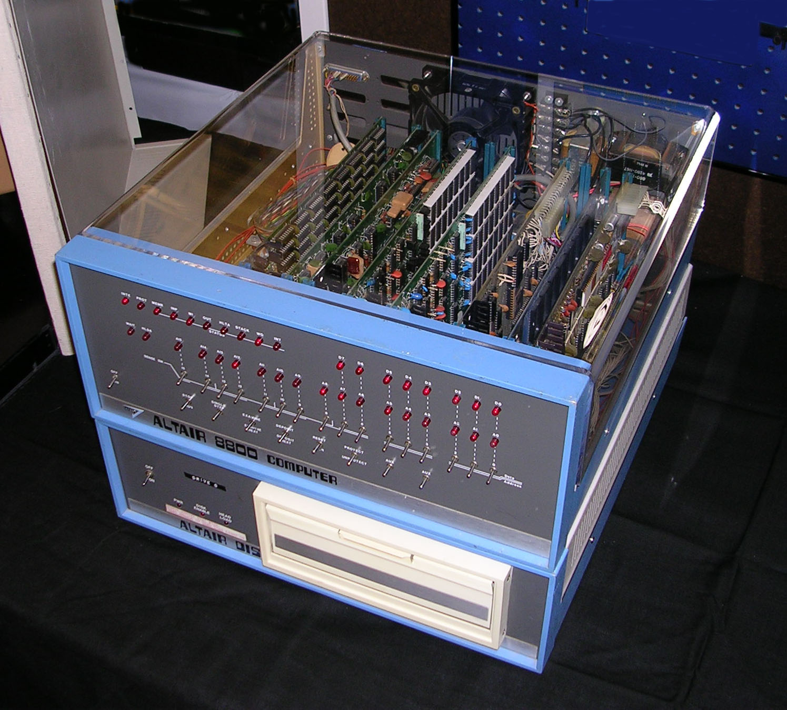
How large is large?
It depends…
In the early days (before 80s): 1 Kilobyte is big.
The first computer ENIAC has 1 KB of core memory (equivalent memory space).
Personal consumer computer Altair is equipped with 4 KB memory. (1975)

Slide 4

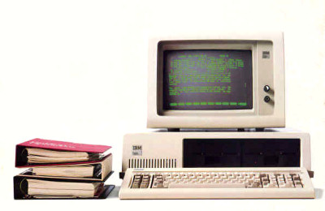
In the 80s
1 Megabyte of data is considered as big.
Apple’s Macintosh came with 128 KB of memory.
IBM PC has 16 KB ~ 256 KB of memory.

Slide 5

In the 90s
1Gigabyte is big.
My first computer has 512 KB of memory ☺
When it retired in 1998, its memory has been upgraded to 12 MB ☺
Picture from the Internet

Slide 6
In the Web-Age
10 Gigabytes?
100 Gigabyte?
1 Terabyte?
1 Petabyte?
…??

Slide 7

Pictures from MBAonline.com

Slide 8
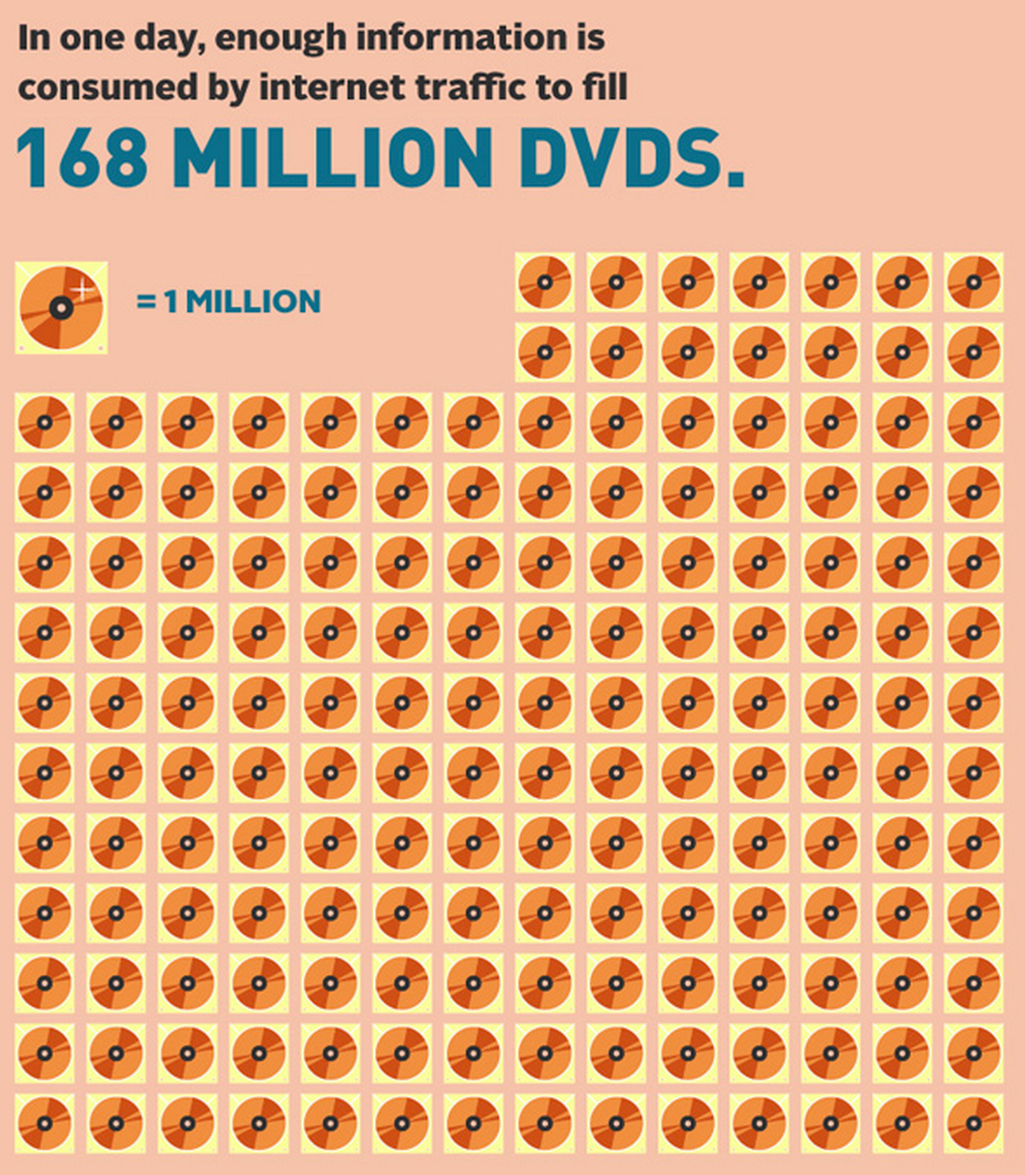
Picture from the Internet

Slide 9
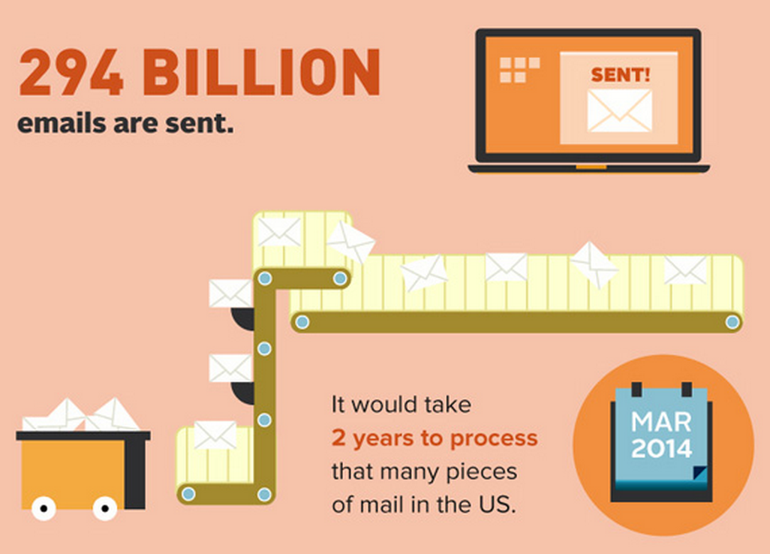
Picture from the Internet

Slide 10

Picture from the Internet

Slide 11
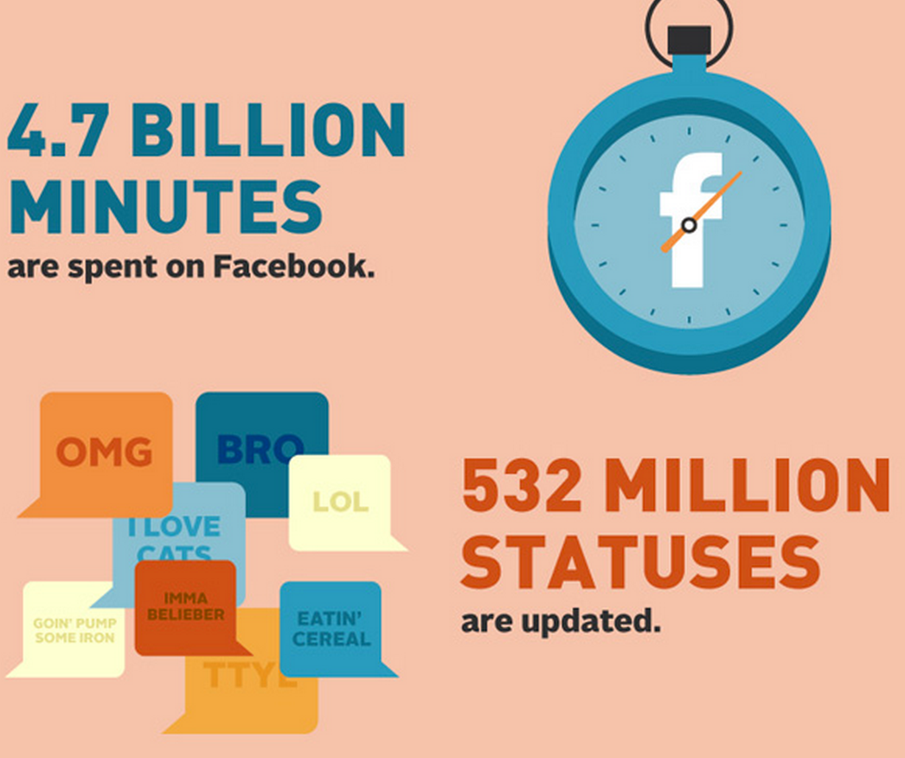
Picture from the Internet

Slide 12
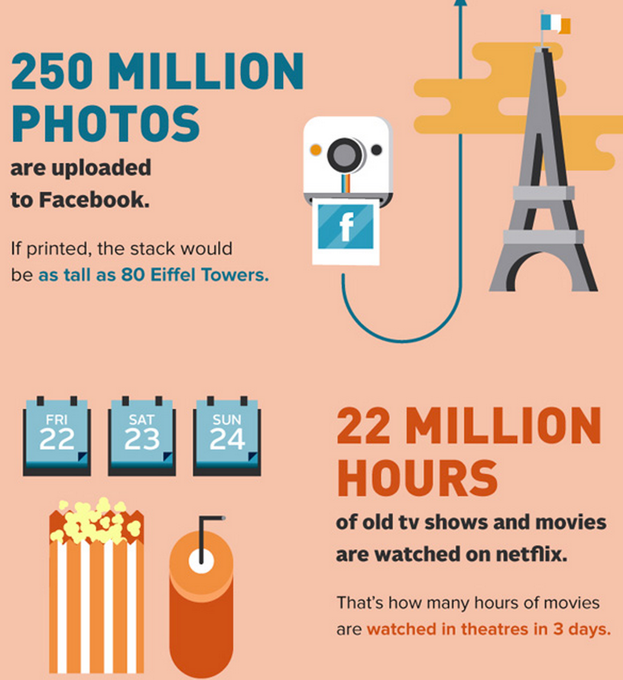
Picture from the Internet

Slide 13
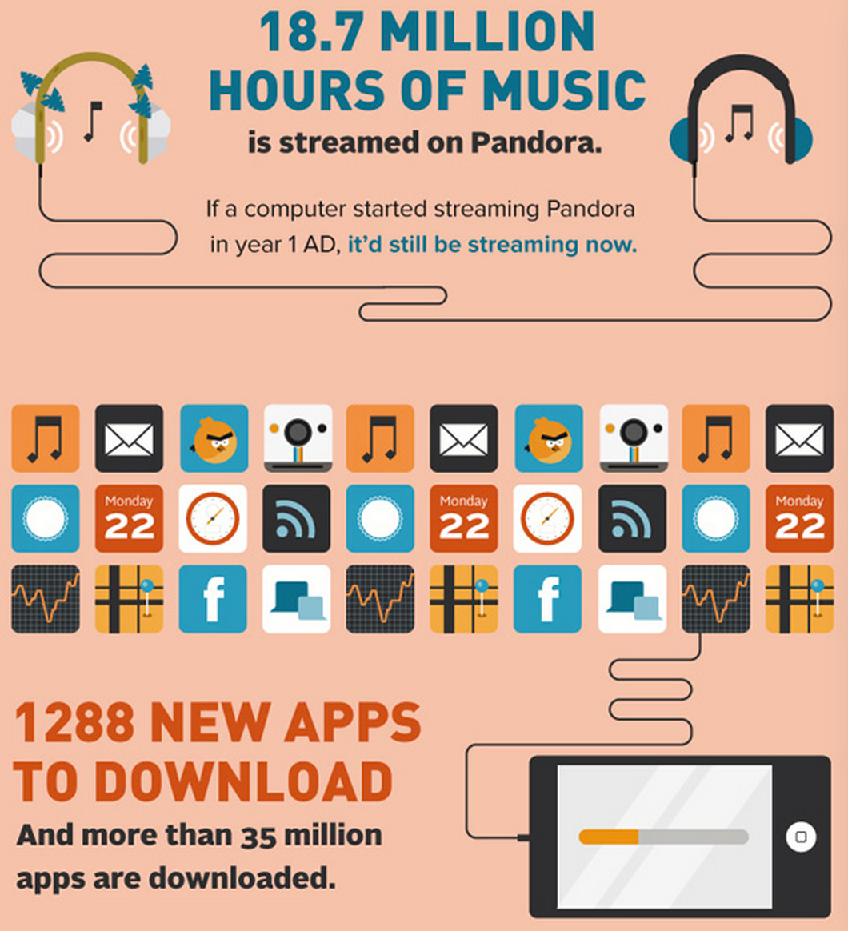
Picture from the Internet

Slide 14
How do we make use of these data?
Large Scale
Data Mining
Why not ‘classical’ data mining?

Slide 15
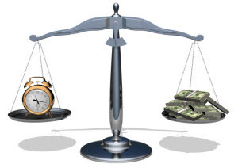
Data cannot be efficiently processed by one machine
The algorithms as well as their implementations are mainly single machine version.
Most of them run in single thread/process.
Time is money!

Slide 16

Out of Memory
Data cannot be load into memory.

Slide 17
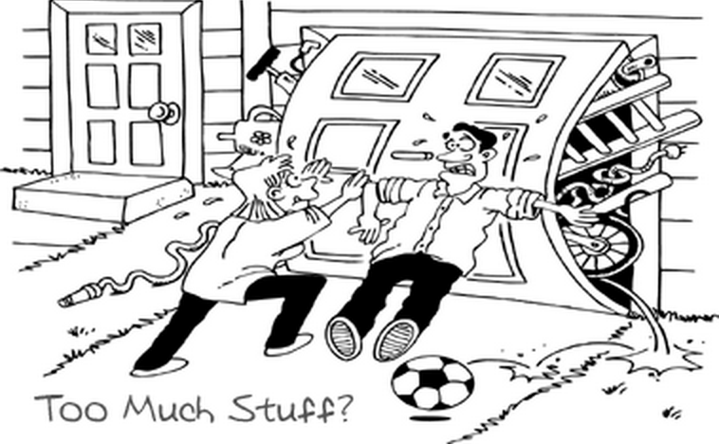
Out of Storage Space
Data cannot be stored in one machine. No single computer can store petabytes of data.

Slide 18
The Foundation of Large Scale Data Mining
Infrastructure
Machines
High speed interconnection
Auxiliary devices
Framework
MapReduce
Bulk Synchronous Parallel
Distributed Real Time Computing Framework
Algorithm
Parallelization
Online Learning

Slide 19
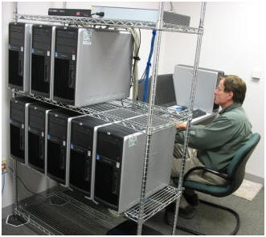
Computers. A lot of them!
You probably need.
A small cluster

Slide 20
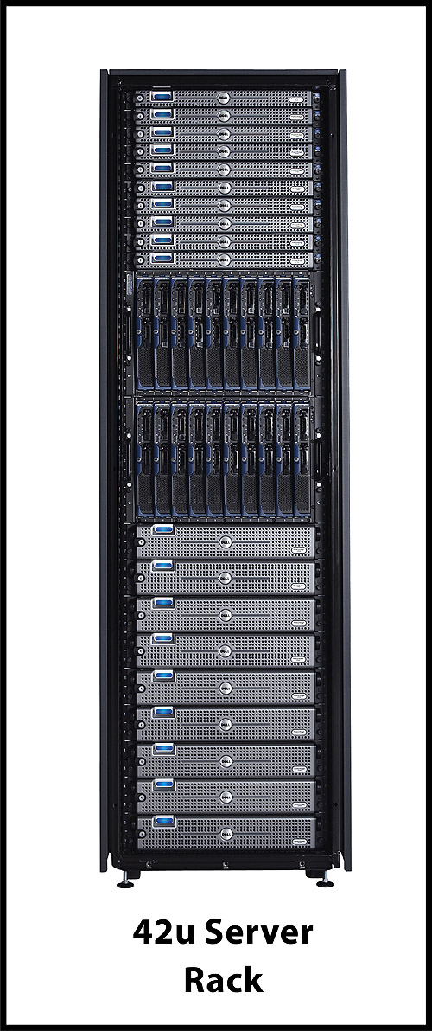

Computers. A lot of them!
You probably need.
Or a rack Or a data center
A small cluster

Slide 21
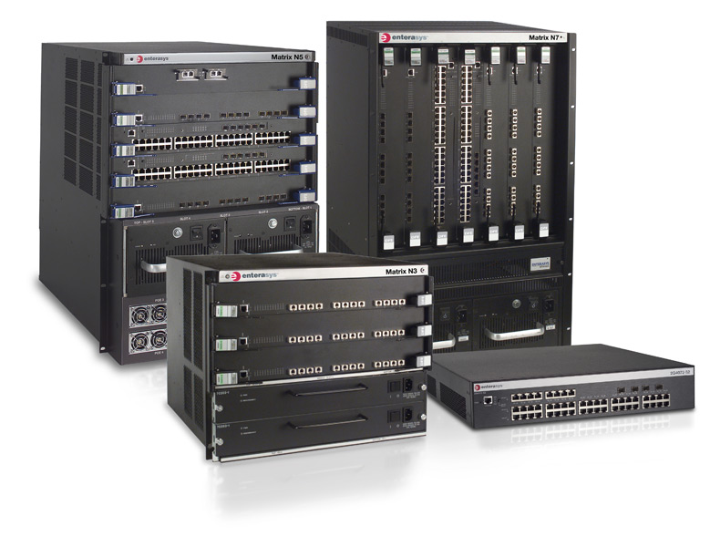
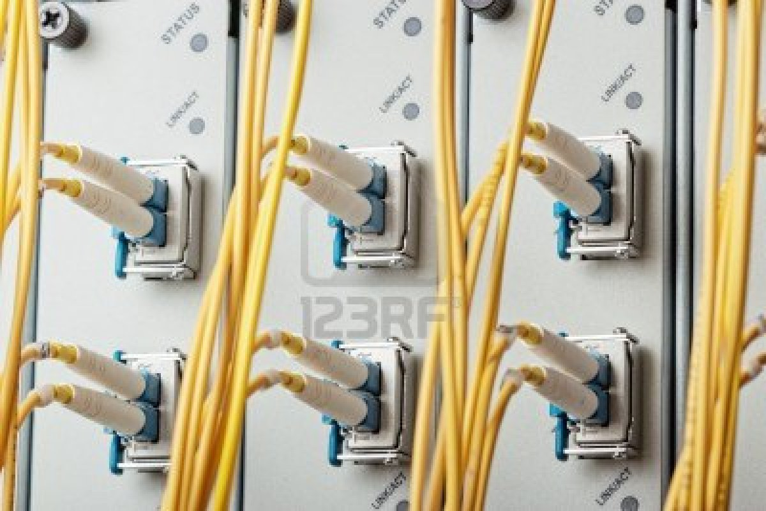
The Auxiliaries
Network
Routers
Cables

Slide 22

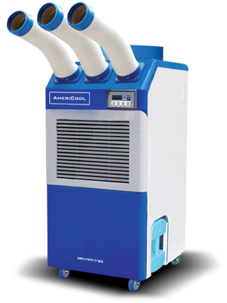
The Auxiliaries
Network
Routers
Cables
Cooling
Air conditioners
Water cooling devices

Slide 23
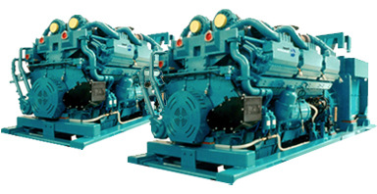
The Auxiliaries
Network
Routers
Cables
Cooling
Air conditioners
Water cooling devices
Power Management

Slide 24




Those cost too much!
Use (IaaS) cloud service

Slide 25





Computing Framework
Map-Reduce
Hadoop
Bulk Synchronous Parallel (BSP)
Giraph
Hama
In-memory Cluster Computing
Spark
Real Time Computing Framework
Storm

Slide 26
Map-Reduce: Algorithmic Perspective
Map-Reduce is not a new concept!
Map and Reduce are two commonly used operations.
Map: A high order function that applies a function (a.k.a. Transformer) to each element of the list.
Reduce: A high order function that applies a combiner function to a list of elements.

Slide 27
Map
map (function, list)
Example:
Convert all the letters to lower case:
map(toLower, “HeLLO, World!”) -> “hello, world!”
Count the number of words of each element
map(wordCount, [“hello world”, “good evening”, “hi”]) -> [2, 2, 1]
Inverse the key and value of each element
map(inverse, [“key1”: “value1”, “key2”: “value2”]) -> [“value1”: “key1”, “value2”: “key2”]

Slide 28
Reduce
reduce(function, list)
Example:
Get the sum of a list of elements
reduce(plus, [1, 2, 3, 4, 5]) -> 15
+
1
2
3
4
5

Slide 29
Reduce
reduce(function, list)
Example:
Get the sum of a list of elements
reduce(plus, [1, 2, 3, 4, 5]) -> 15
+
+
1
2
3
4
5

Slide 30
Reduce
+
reduce(function, list)
Example:
Get the sum of a list of elements
reduce(plus, [1, 2, 3, 4, 5]) -> 15
+
+
+
1
2
3
4
5

Slide 31
Reduce
+
reduce(function, list)
Example:
Get the sum of a list of elements
reduce(plus, [1, 2, 3, 4, 5]) -> 15
+
+
+
1
2
3
4
5

Slide 32
Reduce
+
reduce(function, list)
Example:
Get the sum of a list of elements
reduce(plus, [1, 2, 3, 4, 5]) -> 15
Aggregate the keys to but inverse index
reduce(aggregate, [“key1”: “value1”, “key1”: “value2”, “key1”: “value3”, “key2”: “value3”] -> [“key1”: [“value1”, “value2”, “value3”], “key2”: “value3”]
+
+
+
1
2
3
4
5

Slide 33
Map-Reduce： Parallel Computing Perspective
Distributed computing framework running on top of commodity computers.
First time draw attention.
Google’s distributed computing framework: MapReduce: Simpliﬁed Data Processing on Large Clusters, OSDI 2004.
Get popular.
Apache Hadoop. Doug Cutting and Mike Cafarella et al. 2005.
1.2.X Hadoop 1.
2.2.X Hadoop 2 (YARN).

Slide 34
Why Map-Reduce?
The size of data has far beyond the processing capability of the single machine.
Example: A small search engine
20+ billion billion web pages x 20KB = 400+ TB
1 computer reads 30-35MB/sec from disk would use 4+ month to just read all the data.
~1000 hard drives to store the data.
Much more time to do something to the data…

Slide 35
Why Map-Reduce? (Cont)
Super-computer
Too expensive
Requires non-trivial extra time to train the programmer
Traditional parallel computing framework
Requires knowledge of low-level details: communication, fault-tolerance
Difficult to maintain
Programmer would be distracted

Slide 36
Fundamentals of Map-Reduce
Two Main Steps:
Map: Extract something you care about.
Map<Key1, Value1> -> Key2, Value2
Reduce: Aggregate, Summarize, Filter, Or Transform
Reduce<Key1, List(Value1)> -> Key2, Value2

Slide 37

Apache Hadoop
A Java implementation of Map-Reduce.
Initialized by Yahoo!
An Apache open source project. Initially a sub-project of Apache Nutch, a web crawler system.

Slide 38

Architecture of Hadoop 1
Hadoop is not only Map-Reduce.
Hadoop Map-Reduce Computing Framework
Hadoop Distributed File System (HDFS)

Slide 39
Architecture of Hadoop 2
Hadoop Map-Reduce Computing Framework
Other Computing Framework
Yet Another Resource Negotiator (YARN)
Hadoop Distributed File System (HDFS)

Slide 40
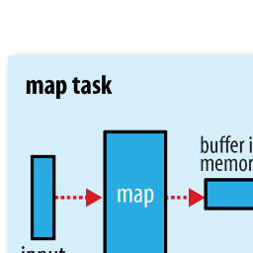
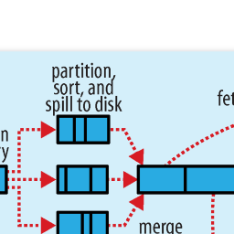
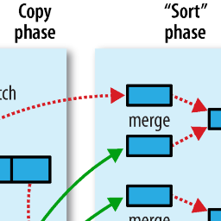
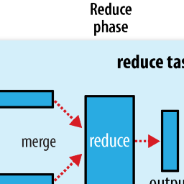

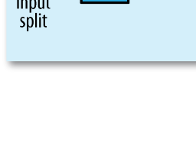
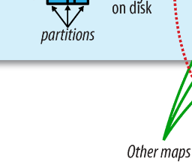
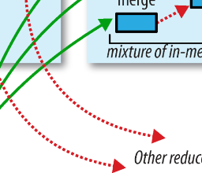
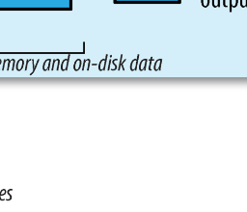

Procedures in Hadoop
from Hadoop: The Definitive Guide

Slide 41
Main API
Mapper:
setup(Context context)
map(Key1 key, Value1 value, Context context)
cleanup(Context context)
Reducer:
setup(Context context)
reduce(Key3 key, Iterable<Value3> values, Context context)
WritableComparable
readFields(DataInput in)
Write(DataOutput out)
compareTo
Partitioner, InputFormat, InputSplit

Slide 42
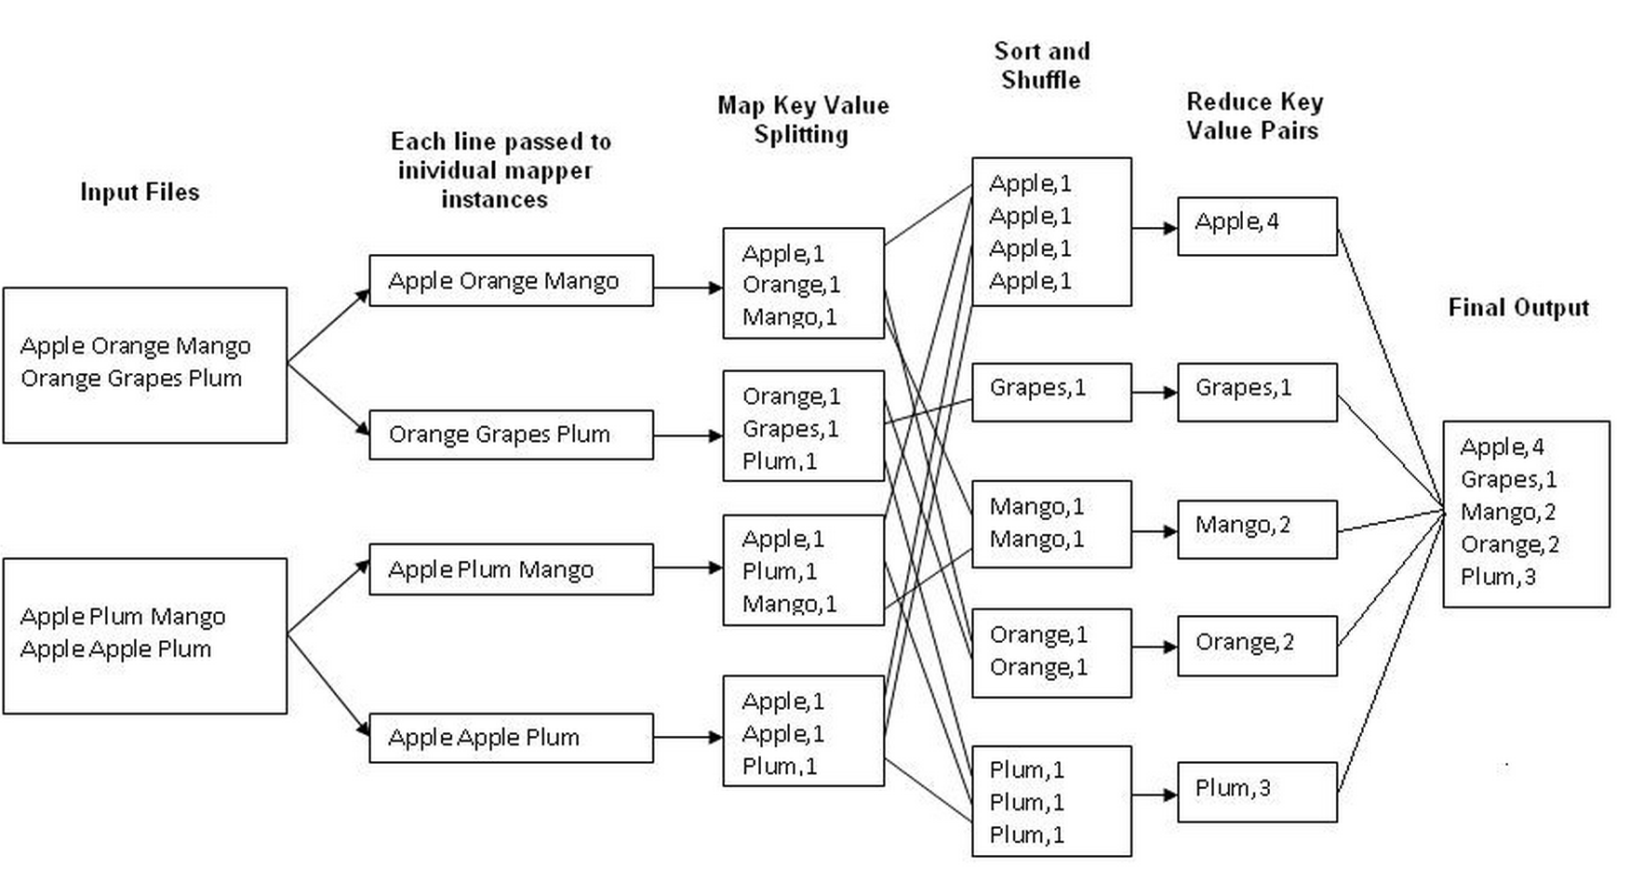
“Hello World” in Hadoop
Wordcount: count the number of each distinct word in a given set of documents.

Slide 43
Data Mining Algorithms on Top of Mapreduce
What data mining algorithms are suitable to be implemented in MapReduce style?

Slide 44
Data Mining Algorithms on Top of Mapreduce
What data mining algorithms are suitable to be implemented in MapReduce style?
Algorithms can be finished in a constant number of steps
Algorithms that can run in pure parallel (no information exchange between partition)

Slide 45
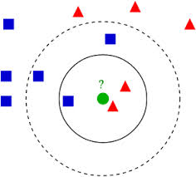
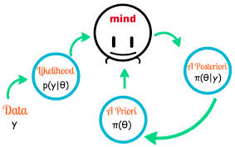
Algorithms Perfect Fit to MapReduce
K-Nearest-Neighbor
Lazy classification
Naïve Bayes
Generative model
Classification

Slide 46
KNN Implementation
Mapper: Find the k-Neareat neighbors locally.
Local Top K
Partition
Mapper
Data
Local Top K
Partition
Mapper
Local Top K
Partition
Mapper

Slide 47
KNN Implementation
Reducer: Get the global k-Nearest Neighbors from all the locally k-Nearest Neighbors.
Local Top-K
1 reducer is enough if k is not too large (< 1M)
Local Top-K
Global KNN
Reducer
Local Top-K

Slide 48
Sample Code
Mapper:
map(LongWritable key, VectorWritable vec, Context context) {
distance = dist(vec, targetVec);
localHeap.add(new Pair(vec, distance);
if (localHeap.size() > k) {
localHeap.pop();
}
}
cleanup(Context context) {
output all elements in localHeap (key is a constant, value is the pair)
}
Reducer:
reduce(LongWritable key, Iterable<Pair> vecIterable) {
for each pair {
globalHeap.add(pair);
if (globalHeap.size() > k) {
globalHeap.pop();
}
output the majority of label
}
}

Slide 49
Naïve Bayes Training
Example: Text Classification Scenario
Given a set of training documents D = {d_{i}, c_{j}}, build a naïve bayes classifier.
Prerequisite: Feature extraction.
Use bag-of-word to represent a document with count vector.
Each document can be represented as d_{i} = [#w₁, #w₂, …, #w_{n}].
This is just an example, not the optimal solution!

Slide 50
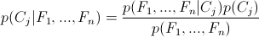
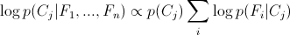
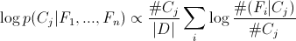
Naïve Bayes Training
The formula:
Easy to get underflow

Slide 51
Naïve Bayes Training
The formula:
Easy to get underflow
Things need to be calculated:
p(C_{j}): needs #C_{j} and |D|.
p(F_{i} = f_{i}|C_{j}): needs #(F_{i}=f_{i}|C_{j}) and #C_{j}.

Slide 52
Naïve Bayes Implementation
Partition
Mapper
Count #C_{j}, |D|, and each #(F_{i}=f_{i}|C_{i}) locally.
Partition
Mapper
Count #C_{j}, |D|, and each #(F_{i}=f_{i}|C_{i}) locally.
Partition
Mapper
Count #C_{j}, |D|, and each #(F_{i}=f_{i}|C_{i}) locally.

Slide 53
Naïve Bayes Implementation
Local counts
Reducer
Local counts
Reducer
Each Reducer counts #C_{j}, |D|, and each #(F_{i}=f_{i}|C_{i}) globally.
Local counts
Reducer

Slide 54
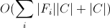
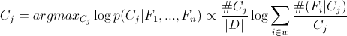
Sample Code
1 Job for training
Mapper: count the local #C_{j}, |D|, and #(F_{i}|C_{j})
Reducer: get the global #C_{j}, |D|, and #(F_{i}|C_{j}).
Classification:
Load the probabilities from file into memory. Space costs
Given a test document with feature vector w, estimate the probability of belongings to each class.

Slide 55
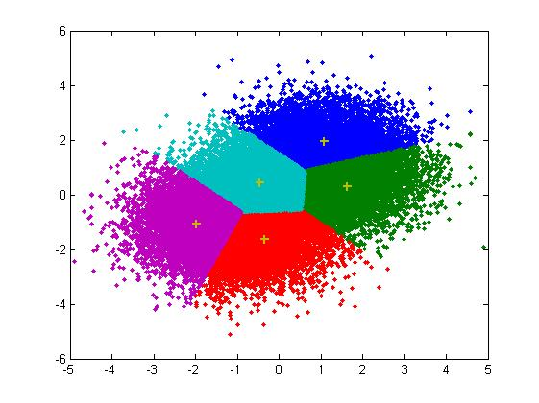
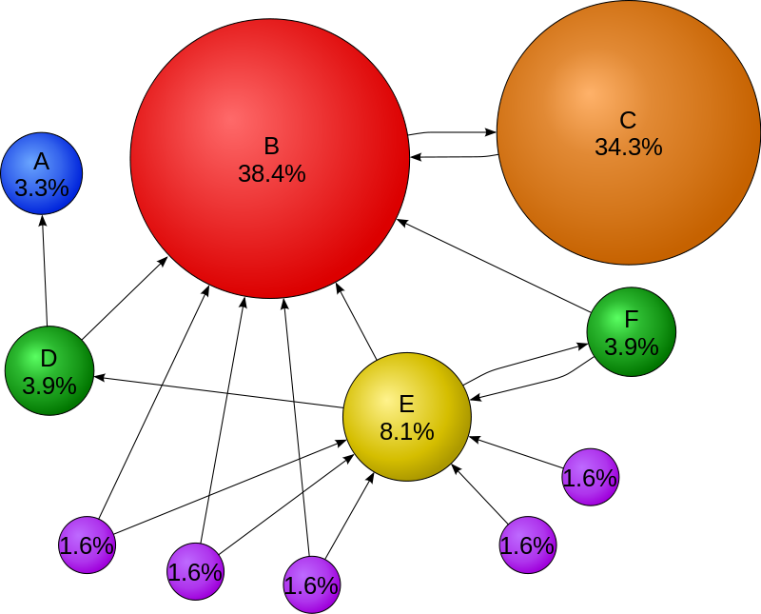
OK but not efficient
Kmeans
Iterative algorithm
Clustering a set of instance into k clusters
Pagerank
Graph algorithms
Score the entities by their in-links

Slide 56
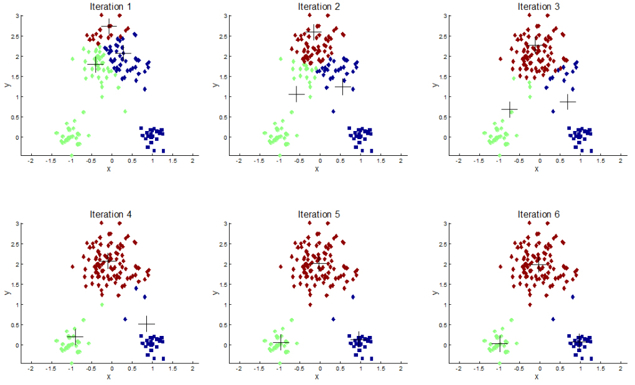
Kmeans Revisited
Copy from Andrei Pandre’s blog

Slide 57
Kmeans Implementation
Pseudocode: (Naïve solution)
Initialize Clusters
Load cluster information into distributed cache
do
Assign points to clusters
Write intermediate data back
Read intermediate data
Recalculate cluster center
while not converged
Cluster Assignment Job
Center Recalculation Job

Slide 58
Cluster Assignment Job
Driver: Randomly initialize cluster centers
Mapper:
setup(Context context) {
read cluster centers into memory.
}
map(LongWritable key, VectorWritable vec, Context context) {
for each center {
calculate the distance between vec and the center.
}
context.write(nearestCenterId, vec);
}
Reducer: (Identity Reducer)
map(LongWritable centerId, Iterable<VectorWritable> list, Context context) {
for each element in list {
context.write(centerId, vec);
}
}

Slide 59
Center Recalculation Job
Driver; Read assignment data
Mapper: (Identity Mapper)
map(LongWritable centerId, VectorWritable vec, Context context) {
context.write(centerId, context);
}
Reducer:
reduce(LongWritable centerId, Iterable<VectorWritable> list, Context context) {
Initialize an all-zero vector newCenter
int count = 0;
for each vector in list {
++count;
newCenter += vector;
}
newCenter /= count;
}

Slide 60
Center Recalculation Job
Driver; Read assignment data
Mapper: (Identity Mapper)
map(LongWritable centerId, VectorWritable vec, Context context) {
context.write(centerId, context);
}
Reducer:
reduce(LongWritable centerId, Iterable<VectorWritable> list, Context context) {
Initialize an all-zero vector newCenter
int count = 0;
for each vector in list {
++count;
newCenter += vector;
}
newCenter /= count;
}
This Reducer is not scalable
How to deal with overflow?

Slide 61
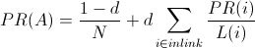
PageRank Algorithm
The PageRank score of page A:
Data format:
PageId, <List of PageIds of outlink>
Steps:
Initialize PageRank score of all pages to the same value.
do
Update PageRank score of each page
while converge
N: number of pages
d: damping factor
L(i): # outlink of page i

Slide 62
PageRank Implementation
Data Types
PageWritable {
Integer pid;
Double PR;
List<Integer> outlinks;
}
Is it scalable?
Unique ID of a page
The PageRank score of a page
The ID of the pages that current page link to

Slide 63
PageRank Implementation
Mapper:
map(PageWritable key, PageWritable page, Context context) {
for each out page pid in page.outLinks {
context.write(pid, page);
}
}
Reducer:
reduce(LongWritable pageId, Iterable<PageWritable> inLinkList, Context context){
PR(pageId) = (1 – d) / N;
for each inLink in inLinkList {
PR(pageId) += d * PR(inLink) / L(inLink)
}
}
How to save space?

Slide 64
Apache Mahout
A scalable machine learning and data mining library. Current stable version 0.8. http://mahout.apache.org/.
Classification:
Multinomial Naïve Bayes
Random Forest
…
Clustering:
Kmeans Clustering
Spectral Clustering
Fuzzy Kmeans
…
Recommendation:
User and item based recommendation
…
Dimensional Reduction, Topic Modeling, Regression, Matrix Factorization
Singular Value Decomposition
Latent Dirichlet Allocation
Hidden Markov Model
…

Slide 65
Apache Mahout
Implemented but not distributed algorithms
Logistic Regression
SVM
Linear Regression

Slide 66
What is missed?
Classification:
Decision tree based classifier: CART, J48
KNN
Distributed Logisitic Regression
Distributed SVM
Clustering:
DBSCAN
Hierarchical Clustering
Matrix Factorization:
Non-Negative Matrix Factorization

Slide 67
Limitation of Map-Reduce
Large overhead (10-20 seconds start up time)
Not inherently support iteration
No message passing
Cannot get results in real time.

Slide 68
Limitation of Map-Reduce
Large overhead (10-20 seconds start up time)
Not inherently support iteration
No message passing
Cannot get results in real time.
Extensions:
HaLoop: Efficient Iterative Data Processing on Large Clusters, VLDB 2010.
Twister: Iterative Hadoop. http://www.iterativemapreduce.org/.

Slide 69
Hadoop 2 Ecosystem
MapReduce
YARN Resource Management
HDFS

Slide 70



Hadoop 2 Ecosystem
MapReduce
YARN Resource Management
HDFS

Slide 71


Hadoop 2 Ecosystem
MapReduce
YARN Resource Management
HDFS

Slide 72


MapReduce vs. BSP
Data Intensive
Low communication needs
Complex Computation Intensive
High communication needs
Copy from Edward Yoon’s slides of Hadoop in Seoul 2013

Slide 73
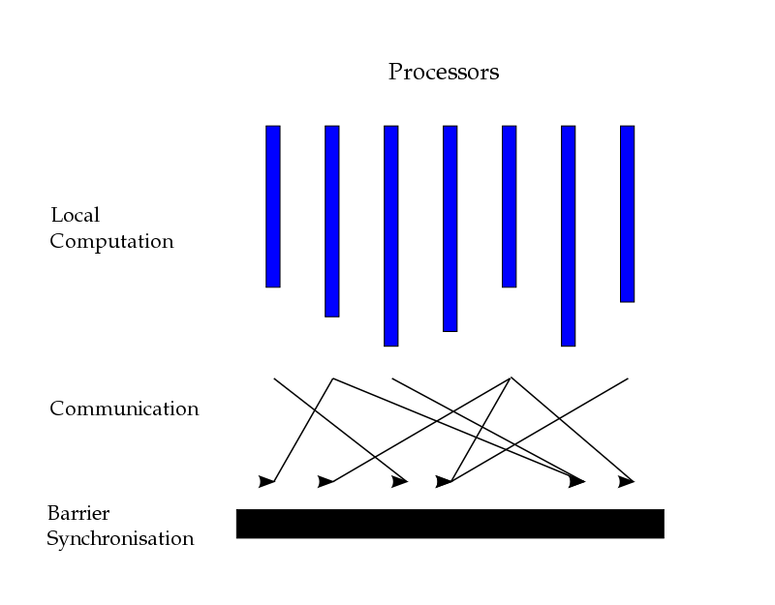
Bulk Synchronous Parallel
A bridge model for designing parallel algorithms.
Computation consists of a series of supersteps.
Concurrent computing.
Communication.
Barrier synchronization.
Copy from Wikipedia

Slide 74
Why BSP?
Transition of the Technologies
2003~:
SQL Database connectivity interface
Web-scale data processing
MapReduce
Hive, Pig, Hbase
2007~:
Key/Value interface
Realtime, Iterative, and Graph processing
Storm, etc.
Apache Hama, etc.
GraphLab, Apache Giraph, Spark, etc.

Slide 75
Advantage of BSP?
Low latency between iterations (supersteps).
Suitable for implementing iterative algorithm.
E.g. kmeans
Low latency for information exchange (communication).
Suitable for implementing algorithms that need global or neighborhood information.
E.g. graph algorithms

Slide 76

Apache Giraph
An iterative graph processing system built for high scalability.
An open source version of Google’s Pregel.
Current stable version: 1.0.0
Currently mainly developed and maintained by Facebook

Slide 77
Fundamentals of Giraph
Graphs are composed of vertices and edges.
Vertex centric computing framework.
Superstep 1
Superstep 2
Superstep 3
Vertex 1
Vertex 1
Vertex 1
Vertex 2
Vertex 2
Vertex 2
Vertex 3
Vertex 3
Vertex 3

Slide 78
Giraph Workflow
Load the graph from disk.
Assign vertex to workers.
Write the result to disk.
Process messages.
Iterate on active vertices.
Call vertices compute.
Send messages to workers.
Compute aggregators.
Checkpoint.

Slide 79
Fundamentals of Giraph
Core entity types:
Vertex ID: Identify a vertex
Implements WritableComparable. Typically a LongWritable.
Vertex Value: Store a vertex associated data.
Implements Writable. Can contain anything that implements Writable.
Edge Value: Store a value on an outgoing edge.
Implements Writable. Can contain anything that implements Writable.
Message Value
Implements Writable. Can contain anything that implements Writable.

Slide 80
Core API
VertexReader: Read the vertices from an input split.
getCurrentVertex(): An iterator method to retrieve the current vertex.
Vertex: Store the vertex data, edge data of a vertex.
compute(Iterable message): The core computing logic of each vertex.

Slide 81
Giraph Basic Example
Connected Component
In each superstep:
Process received messages.
Get the id with smallest number.
Send id to all neighbors whose id is larger than current vertex.
1
3
1
3
1
3
4
3
3
2
1
1
6
6
3
5
5
1

Slide 82
Performance
According to Sebastian Schelter’s reports.
Setup: 6 machines with 2x 8-core cpu, 4x1TB disks, 32G RAM each machine, 1 Giraph worker per core.
Experiment:
Data: Wikipedia page link graph (6M pages, 200M edges)
Experiments:
PageRank on Hadoop/Mahout
10 iterations approx. 29 min
Average time per iteration: approx. 3min
PageRank on Giraph
30 iterations approx. 15 min
Average time per iteration: approx. 30sec
6x Performance Improvement

Slide 83
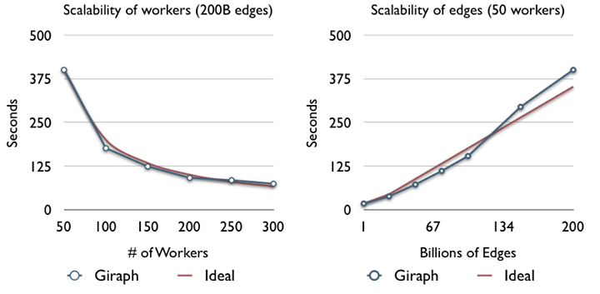
Performance (Cont.)
An experiment conducted by Facebook on 200 billion edges

Slide 84
Suitable Algorithms
Most of the graph algorithms
PageRank
Alternative Least Square
Non-Negative Matrix Factorization

Slide 85
Related Materials
Giraph web site: http://giraph.apache.org/
Github: https://github.com/apache/giraph
User mailing list: user@giraph.apache.org
Facebooks engineering blog: https://www.facebook.com/Engineering

Slide 86
Apache Hama
An implementation of general BSP framework, lead by Edward Yoon in Oracle, now a founder of a stealth startup.
Part of Hadoop 2 ecosystem, running on top of HDFS.
Dedicatedly design for distributed iterative algorithms.

Slide 87
Hama Workflow
Load the data from disk.
Assign partitions to workers.
Write the result to disk.
Process received messages.
Conduct local computing.
Send messages to workers.
Compute aggregators.
Checkpoint.

Slide 88
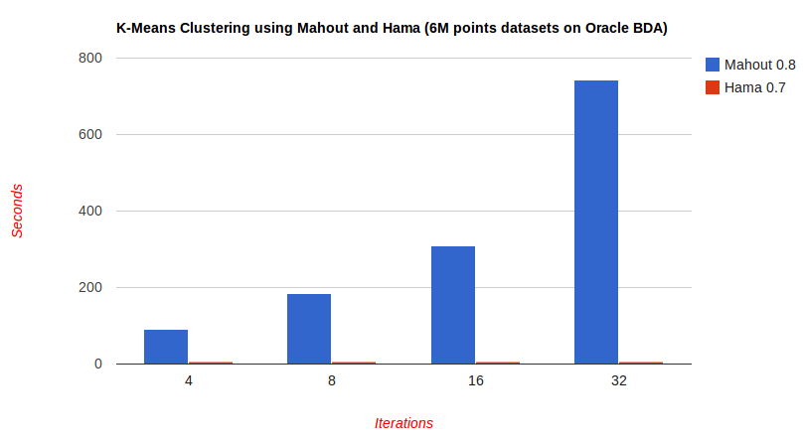
Performance Evaluation
Kmeans performance comparison (100x faster)

Slide 89
More Performance Evaluation
PageRank
Machine: 1 Rack Oracle BDA (18 nodes), 170 tasks
Dataset: 5,716,808 pages and 130,160,392 links.
Execution Time: 18.465 seconds.
Single Source Shortest Path (SSSP)
Machine: 1 Rack Oracle BDA (18 nodes), 180 tasks.
Dataset: 1 Billion Edges.
Execution Time: 473.52 second.

Slide 90
Fundamental of Hama
BSP (interface):
setup(BSPPeer): Conduct the initialization task, e.g. load parameters. Called before bsp.
bsp(BSPPeer): Conduct the core computation.
cleanup(BSPPear): Conduct the clean up tasks, e.g. write results to disk. Called after bsp.
BSPPeer:
send(String peerName, M msg): Send a message to a peer.
sync: Enter the barrier synchronization stage.
readNext(K key, V value): Read a key/value pair from input stream.
write(K key, V value): Write a key/value pair to output collector.
reopenInput: Reopen the input and read from the beginning.
getCurrentMessage: Get the current message from a FIFO.
…

Slide 91
Sketch of a typical Hama Program
Sketch implements BSP {
public void setup(BSPPeer peer) {
Conduct initialization task.
}
public void cleanup(BSPPeer peer) {
Conduct cleanup task.
}
public void bsp(BSPPeer peer) {
while (condition not satisfied) {
1. Open or reopen the input stream.
2. Computing.
3. Send message to peers.
4. Sync
5. Process the incoming messages.
}
}
}

Slide 92
“Hello World!” of Hama
public class ClassSerializePrinting extends BSP<NullWritable, NullWritable, IntWritable, Text> {
public static final int NUM_SUPERSTEPS = 15;
public void bsp(BSPPeer<NullWritable, NullWritable, IntWritable, Text> bspPeer) {
for (int i = 0; i < NUM_SUPERSTEPS; i++) {
for (String otherPeer : bspPeer.getAllPeerNames()) {
bspPeer.send(otherPeer, new IntegerMessage(bspPeer.getPeerName(), i));
}
bspPeer.sync();
IntegerMessage msg = null;
while ((msg = (IntegerMessage) bspPeer.getCurrentMessage()) != null) {
bspPeer.write(new IntWritable(msg.getData()), new Text(msg.getTag()));
}
}
}
}
Send Messages
Synchronization

Slide 93
Fundamental of Hama Graph
VertexInputReader:
parseVertext(K key, V value, Vertex vertex): parse the input.
Vertex:
compute(M messages): The computing logic of each vertex.
voteToHalt: Once all the vertices vote to halt, the program will terminate.
Sketch:
compute(Iterable<M> messages) {
Initialization.
Process incoming messages.
Core computing.
Check whether vote to halt.
Send messages to neighbors.
}

Slide 94
Suitable Data Mining Algorithms
PageRank
Using Hama’s Graph API
Kmeans
Programming in master/slave style
Neural Network
Programming in master/slave style
Linear Regression
Logistic Regression
Autoencoder

Slide 95
PageRank in Hama
Data format:
VertexID <List of Neighbor IDs>
Graph Initialization:
public boolean parseVertex(Text key, TextArrayWritable value,
Vertex<Text, NullWritable, DoubleWritable> vertex) {
vertex.setVertexID(key);
for (Writable v : value.get()) {
vertex.addEdge(new Edge<Text, NullWritable>((Text) v, null));
}
return true;
}
Add edges

Slide 96
PR Score Computation
public void compute(Iterable<DoubleWritable> messages) {
if (getSuperStep() == 0) {
setValue(new DoubleWritable(1.0 / getNumVertices());
}
else {
double sum = 0;
for (DoubleWritable msg : messages) {
sum += msg.get();
}
setValue(new DoubleWritable((1.0 – DAMPING_FACTOR) / getNumVertices() + (sum * DAMPING_FACTOR));
if (CONVERGENCE_THRESHOLD > getLastAggregatedValue()) {
voteToHalt();
break;
}
sendMessageToNeighbors(new DoubleWritable(getValue().get() / getEdges().size()));
}
}
PR score
PR score
Initialize score
Process incoming message
PR score
PR score

Slide 97
PR Score Computation
public void compute(Iterable<DoubleWritable> messages) {
if (getSuperStep() == 0) {
setValue(new DoubleWritable(1.0 / getNumVertices());
}
else {
double sum = 0;
for (DoubleWritable msg : messages) {
sum += msg.get();
}
setValue(new DoubleWritable((1.0 – DAMPING_FACTOR) / getNumVertices() + (sum * DAMPING_FACTOR));
if (CONVERGENCE_THRESHOLD > getLastAggregatedValue()) {
voteToHalt();
break;
}
sendMessageToNeighbors(new DoubleWritable(getValue().get() / getEdges().size()));
}
}
PR score
PR score
Initialize score
Process incoming message
PR score
PR score
Check termination condition
Send messages to neighbors

Slide 98
Distributed Kmeans in Hama
Initial centers
Assign centers
Update centers
Distribute new centers

Slide 99
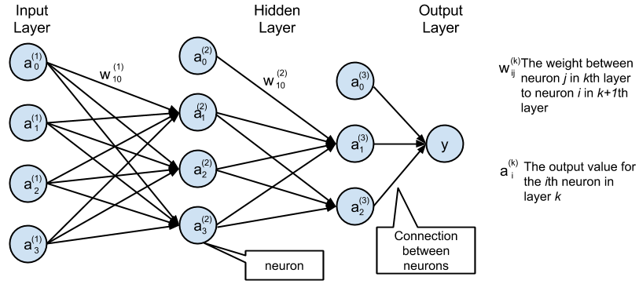
Neural Network in Hama
Train the model via mini-batch stochastic gradient descent.

Slide 100
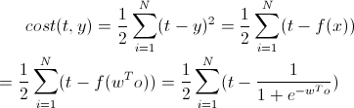
Neural Network in Hama
Cost function
o denotes the output
of the output layer
Sigmoid function
Notes:
cost(t, y) = \frac{1}{2} \sum_{i=1}^N (t - y)^2 = \frac{1}{2} \sum_{i=1}^N (t - f(x)) \\
= \frac{1}{2} \sum_{i=1}^N (t - f(w^T o)) = \frac{1}{2} \sum_{i=1}^N (t - \frac{1}{1 + e^{w^T o}})\\
\frac{\partial cost(t, y)}{\partial w_i} = \frac{\partial cost(t, y)}{\partial f} \frac{\partial f}{\partial x} \frac{\partial x}{\partial w_i} \\
= -\sum_{i=1}^N (t - y) \cdot (f(x) \cdot (1 - f(x))) \cdot o_i \\
= - (\sum_{i=1}^{N_i} (t - y) \cdot (f(x) \cdot (1 - f(x))) \cdot o_i) + \cdots + (\sum_{i=1}^{N_m} (t - y) \cdot (f(x) \cdot (1 - f(x))) \cdot o_i)

Slide 101
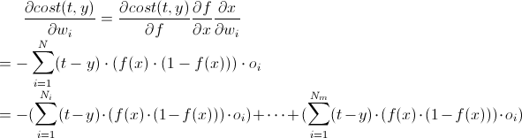
Neural Network in Hama
Cost function
Decompose the weight update
o denotes the output
of the output layer
Each part can be computed independently
Notes:
cost(t, y) = \frac{1}{2} \sum_{i=1}^N (t - y)^2 = \frac{1}{2} \sum_{i=1}^N (t - f(x)) \\
= \frac{1}{2} \sum_{i=1}^N (t - f(w^T o)) = \frac{1}{2} \sum_{i=1}^N (t - \frac{1}{1 + e^{w^T o}})\\
\frac{\partial cost(t, y)}{\partial w_i} = \frac{\partial cost(t, y)}{\partial f} \frac{\partial f}{\partial x} \frac{\partial x}{\partial w_i} \\
= -\sum_{i=1}^N (t - y) \cdot (f(x) \cdot (1 - f(x))) \cdot o_i \\
= - (\sum_{i=1}^{N_i} (t - y) \cdot (f(x) \cdot (1 - f(x))) \cdot o_i) + \cdots + (\sum_{i=1}^{N_m} (t - y) \cdot (f(x) \cdot (1 - f(x))) \cdot o_i)

Slide 102
Distributed Neural Network in Hama
Initial model
Calculate weight
update locally
Aggregate weight
update
Distribute new weight
102

Slide 103
Related Materials
Hama web site: http://hama.apache.org/
Hama wiki: http://wiki.apache.org/hama/
User mailing list: user@hama.apache.org
Book in preparation: Hama in Action, Edward Yoon et al.

Slide 104
Disadvantage of Hadoop Mapreduce and BSP
The computing is not efficient if data can be load into memory of all the machines.
Hadoop, Giraph, and Hama would implicitly write data to disk.
Writing Java code is time-consuming and it is not concise.
It takes very long time to design and implement a distributed program.
One program can easily exceed 1k lines of code and is hard to maintain.

Slide 105
Apache Spark
In-memory cluster computing framework.
Implemented in Scala, a OOP and functional programing language.
Invented by AMP Lab of University of California Berkeley, lead by Michael Franklin, Michael Jordan and Ion Stoica.
Designed and developed by a 79 people team.
Was contributed to Apache Software Foundation in 2013.

Slide 106
How concise it is?
An example of Logistic Regression.
val points = spark.textFile(...).map(parsePoint).cache()
var w = Vector.random(D) // current separating plane
for (i <- 1 to ITERATIONS) {
val gradient = points.map(p =>
(1 / (1 + exp(-p.y*(w dot p.x))) - 1) * p.y * p.x
).reduce(_ + _)
w -= gradient
}
println("Final separating plane: " + w)
Read and cache data
Iteratively update

Slide 107
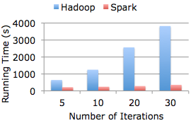
How fast it is?
Data: 30 GB
Machine: 80-core cluster
20x faster

Slide 108

Related Materials
Spark web site: http://spark.incubator.apache.org/
Github: https://github.com/apache/incubator-spark
User mailing list: user@spark.incubator.apache.org
Book: Learning spark, Mark Hamstra and Matei Zaharia.

Slide 109
Real Time Computing Framework
Online algorithms are designed to be trained and evaluated in real time.
Even with “light-fast” clustering computing, the results are not available in read time.
Single machine version algorithms can be used in real time but not scalable.

Slide 110

Apache Storm
Invented by Nathan Marz in Twitter, who is now a founder of stealth startup.
Implemented in Clojure, a pure functional programming.
Contributed to Apache Software Foundation in 2013.
Currently used by many companies.

Slide 111
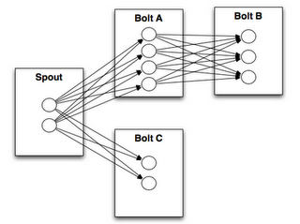
Components
Spout: The source of streams. Can get the data stream from data generator, e.g. message queue.
Bolt: Consumes any number of input streams, does process, and may emit new data stream.
Bolt A
Bolt B
Spout
Bolt C

Slide 112
Core APIs
Spout (Take JMSSpout for example)
setJmsProvider：Specify the user defined JMS provider. A provider is in charge of connecting to the message broker. It will send message to the spout.
setJmsTupleProducer: Specify the user defined JMS producer. A producer is in charge of parsing the received messages from JMS and sending parsed message to the bolt.
Bolt
prepare: Conduct the initialization task.
execute: Conduct the core processing.
cleanup: Conduct the cleanup task.
declareOutputField: Define the format of output.

Slide 113
Word Count in Storm
TopologyBuilder builder = new TopologyBuilder();
builder.setSpout("sentences", new RandomSentenceSpout(), 5);
builder.setBolt("split", new SplitSentence(), 8).shuffleGrouping("sentences");
builder.setBolt("count", new WordCount(), 12).fieldsGrouping("split", new Fields("word"));
Sentences Stream
Spout
Split
Count

Slide 114
Word Count in Storm
SplitBolt
public void execute(Tuple tuple, BasicOutputCollector collector) {
String[] tokens = tuple.getString(0).split(“ “);
for (String token : tokens) {
collector.emit(new Values(word, 1));
}
}
CountBolt
public void execute(Tuple tuple, BasicOutputCollector collector) {
String word = tuple.getString(0);
Integer count = counts.get(word);
if (count == null)
count = 0;
count++;
counts.put(word, count);
collector.emit(new Values(word, count));
}

Slide 115
Machine Learning over Storm
Trident-ml: An online algorithms library over storm.
Linear Classification
Linear Regression
Clustering (Kmeans)
Feature scaling (standardization, normalization)
Text feature extraction
Stream statistics (mean, variance)
Pre-trained Twitter Sentiment Classifier
The packaged algorithms are designed to fit into limited memory and processing time but they don’t work in a distributed way!

Slide 116

Related Materials
Storm website: http://storm-project.net/
Storm github: https://github.com/nathanmarz/storm
Book: Get started with storm, Jonathan Leibiusky, Gabriel Eisbruch, Dario Simonassi.
Mailing list:
user@storm.apache.incubator.org

Slide 117
Summary
This is the big data era.
Most of the practical ML and DM projects in companies are considered to be large scale.
Convert traditional ML and DM algorithms into a distributed algorithms is not as easy as you think.
A typical time period of designing and implementing a new algorithm requires several month in full time.

Slide 118
How to learn more?
Slideshare: Tons of interesting and useful slides.
InfoQ: A practitioner-driven community news site focused on facilitating the spread of knowledge and innovation in enterprise software development.
Top companies’ engineering blog: First-hand resource from the people who invented the things.
Quora: Ask question and get answers from the real domain experts!

